Slide 1
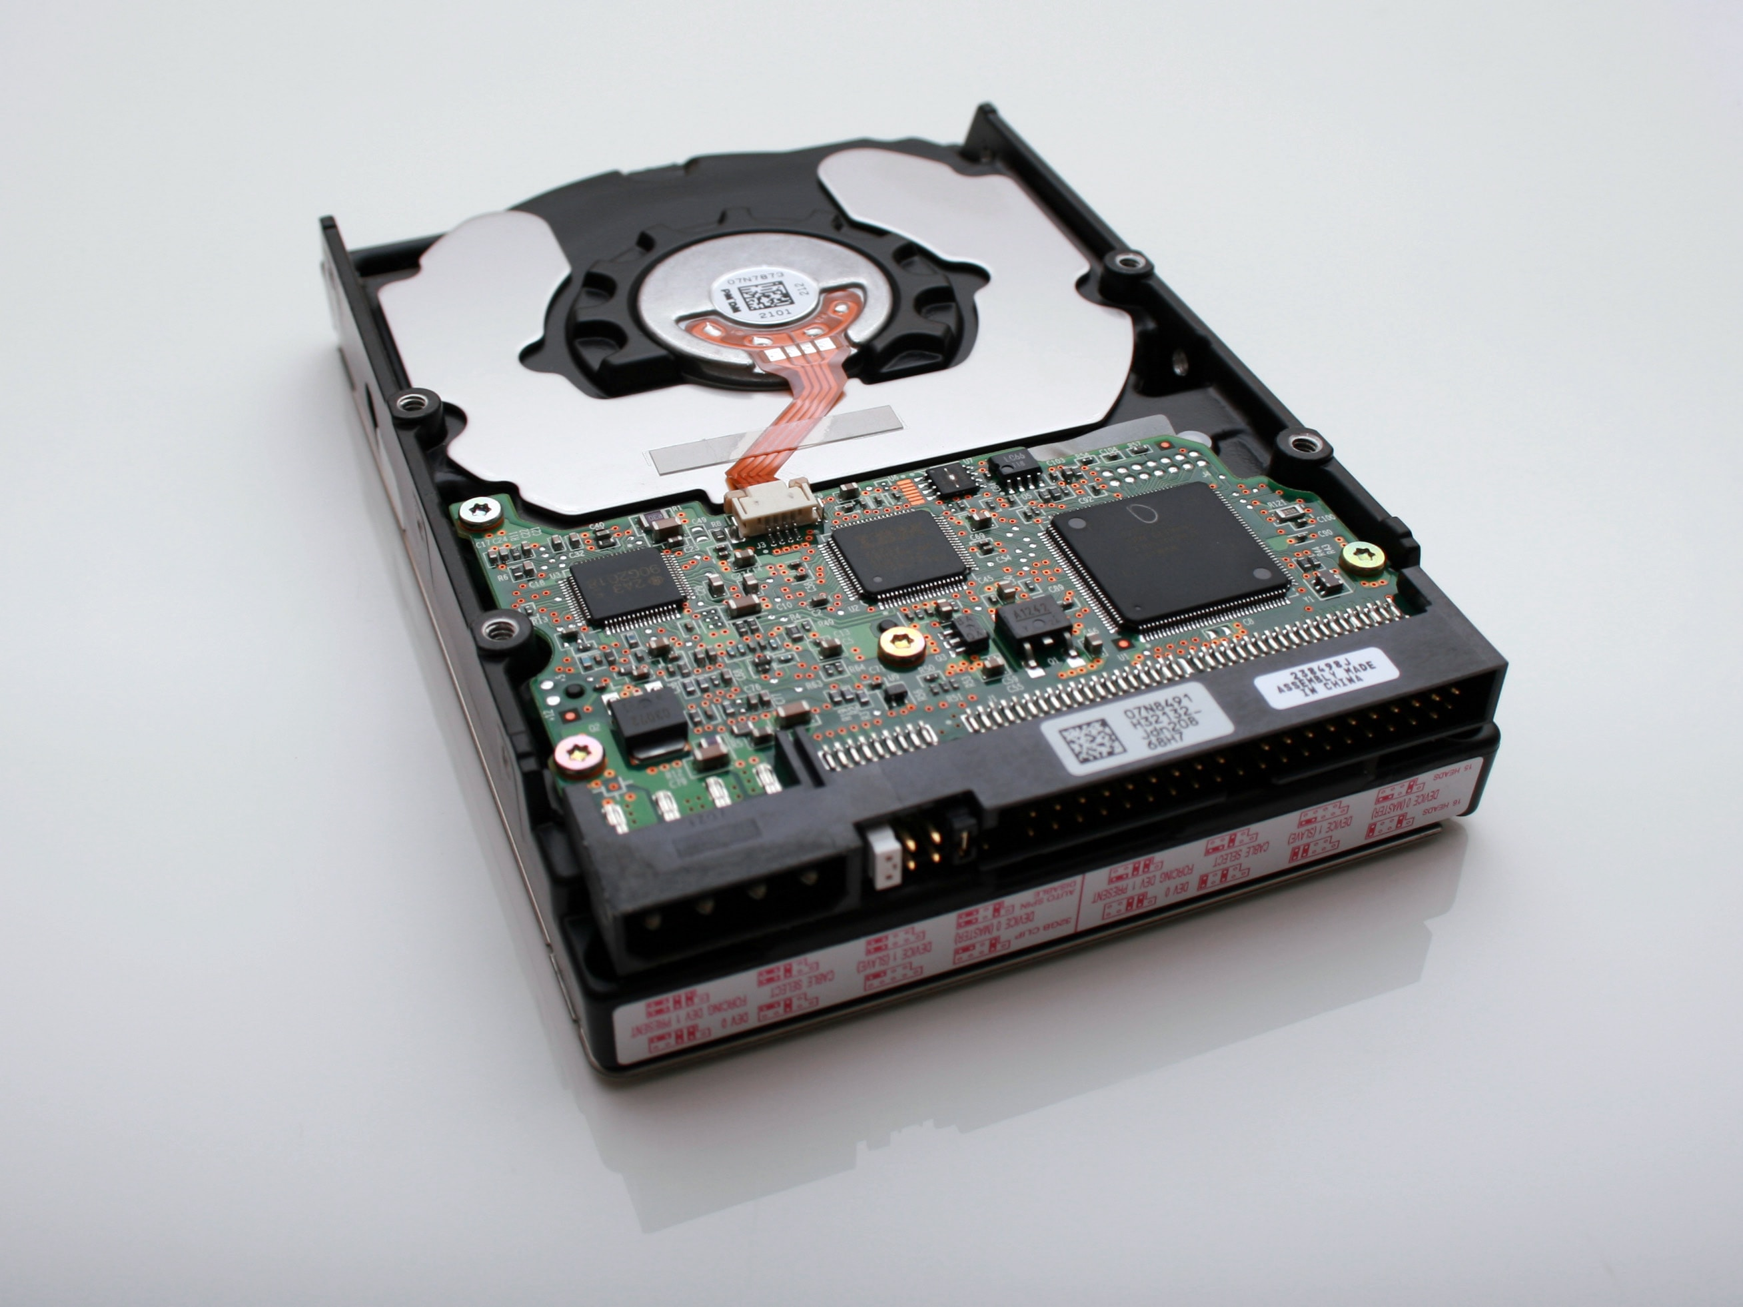
Java In Container
Mateusz Dymiński

Slide 2
whoami
Mateusz Dymiński
Software Developer at Nokia
8+ exp with Java
5+ exp with Go
One of the organizer GoWroc - Golang Wroclaw Meetup
Page: mateuszdyminski.com
Github: github.com/mateuszdyminski
Twitter: @m_dyminski
LinkedIn: linkedin.com/in/mdyminski

Slide 3
Agenda
A
b
c
d
e
f
g
Summary

Slide 4

github.com/mateuszdyminski/java-in-container

Slide 5

Let’s Build Application

Slide 6
Users Application
Users Service
REST API
Storage: MySQL

Slide 7
User
@Entity @Table(name = "users") public class User { @Id @GeneratedValue(strategy = GenerationType.IDENTITY) private Integer id; private String firstName; private String secondName; @Temporal(TemporalType.TIMESTAMP) private Date birthDate; public Integer getId() { return id; } public String getFirstName() { return firstName; } public String getSecondName() { return secondName; } public Date getBirthDate() { return birthDate; } }

Slide 8
Users Controller
@RestController @RequestMapping("/api") public class UsersController { @Autowired UserRepository userRepository; @GetMapping("/users") public List<User> getAllUsers() { return userRepository.findAll(); } @PostMapping("/users") public User createUser(@Valid @RequestBody User user) { return userRepository.save(user); } @GetMapping("/users/{id}") public User getUserById(@PathVariable(value = "id") Integer userId) { return userRepository.findById(userId) .orElseThrow(() -> new ResourceNotFoundException("User", "id", userId)); } }

Slide 9
Users Controller
@RestController @RequestMapping("/api") public class UsersController { @Autowired UserRepository userRepository; @GetMapping("/users") public List<User> getAllUsers() { return userRepository.findAll(); } @PostMapping("/users") public User createUser(@Valid @RequestBody User user) { return userRepository.save(user); } @GetMapping("/users/{id}") public User getUserById(@PathVariable(value = "id") Integer userId) { return userRepository.findById(userId) .orElseThrow(() -> new ResourceNotFoundException("User", "id", userId)); } }

Slide 10
Demo Users Service
Build Users Service
Run
Open
$ mvn package
$ java -jar target/users-app-1.0.jar
http://localhost:8080/api/users

Slide 11

Let’s Dockerize Users App

Slide 12
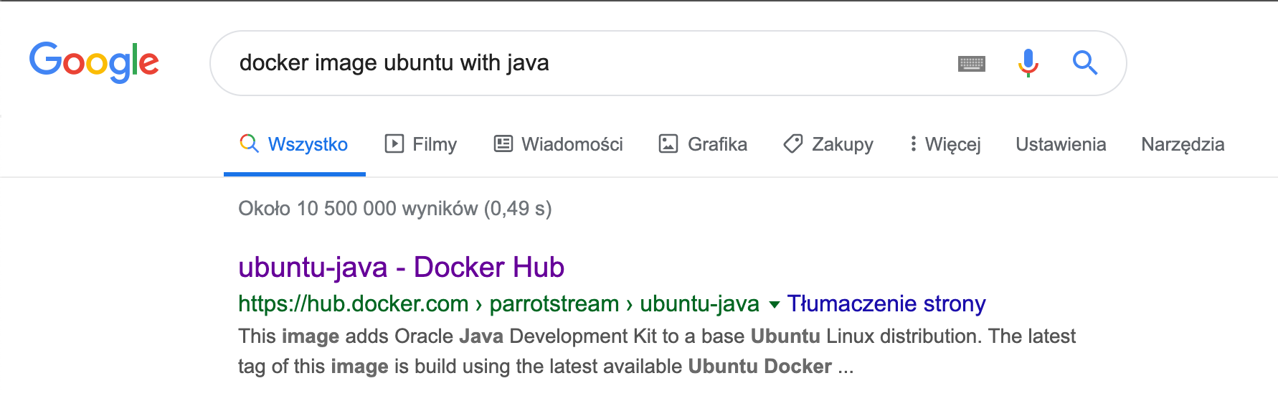

Slide 13
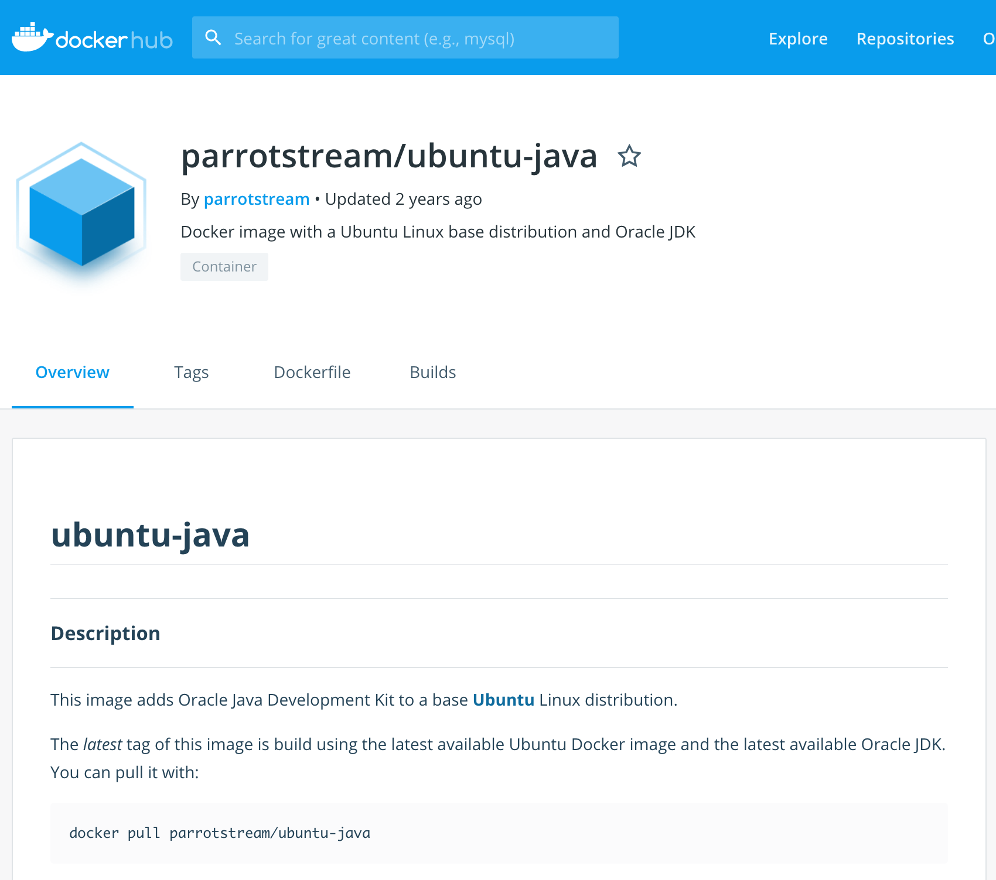

Slide 14
Our very first Dockerfile
FROM parrotstream/ubuntu-java
RUN mkdir -p /var/users-app
COPY target/users-app-1.0.jar /var/users-app/users-app-1.0.jar
COPY run.sh /var/users-app/run.sh
ENTRYPOINT "/var/users-app/run.sh"
And run.sh
#!/usr/bin/env sh
echo "Running users App" /usr/lib/jvm/java-8-oracle/bin/java -jar /var/users-app/users-app-1.0.jar

Slide 15

Let’s get ready for rumble!

Slide 16
Signaling – Entrypoint
We have 2 options while creating ENTRYPOINT:
or different exec where command line is like JSON array:
Long story short: always use the array exec form. The shell form runs your entrypoint as a subcommand of /bin/sh -c which comes with a load of problems, one of them notably that you’ll never see a signal in your application.
ENTRYPOINT "/usr/bin/java -jar /var/users-app/app-1.0.jar"
ENTRYPOINT ["java”, „-jar”, ”/var/users-app/app-1.0.jar”]

Slide 17
Signaling – Script as Entrypoint
Some applications are not suited to be run in ENTRYPOINT and require some logic before they can be started
Use exec - Instead of forking a new process from the existing bash it replaces the shell
Use:
Instead of:
exec /app/bin/your-app
/app/bin/your-app

Slide 18
Signaling part - summary
Use the exec/JSON array form of ENTRYPOINT.
Use exec in shell entrypoints.
Don’t pipe your application’s output.
Avoid being PID 1.
Listen for SIGTERM or set STOPSIGNAL in your Dockerfile.

Slide 19
Our Dockerfile v2
FROM parrotstream/ubuntu-java
RUN mkdir -p /var/users-app
COPY target/users-app-1.0.jar /var/users-app/users-app-1.0.jar
ENTRYPOINT ["/usr/lib/jvm/java-8-oracle/bin/java", "-XshowSettings:VM", "-XX:NativeMemoryTracking=summary", "-jar", "/var/users-app/users-app-1.0.jar"]

Slide 20
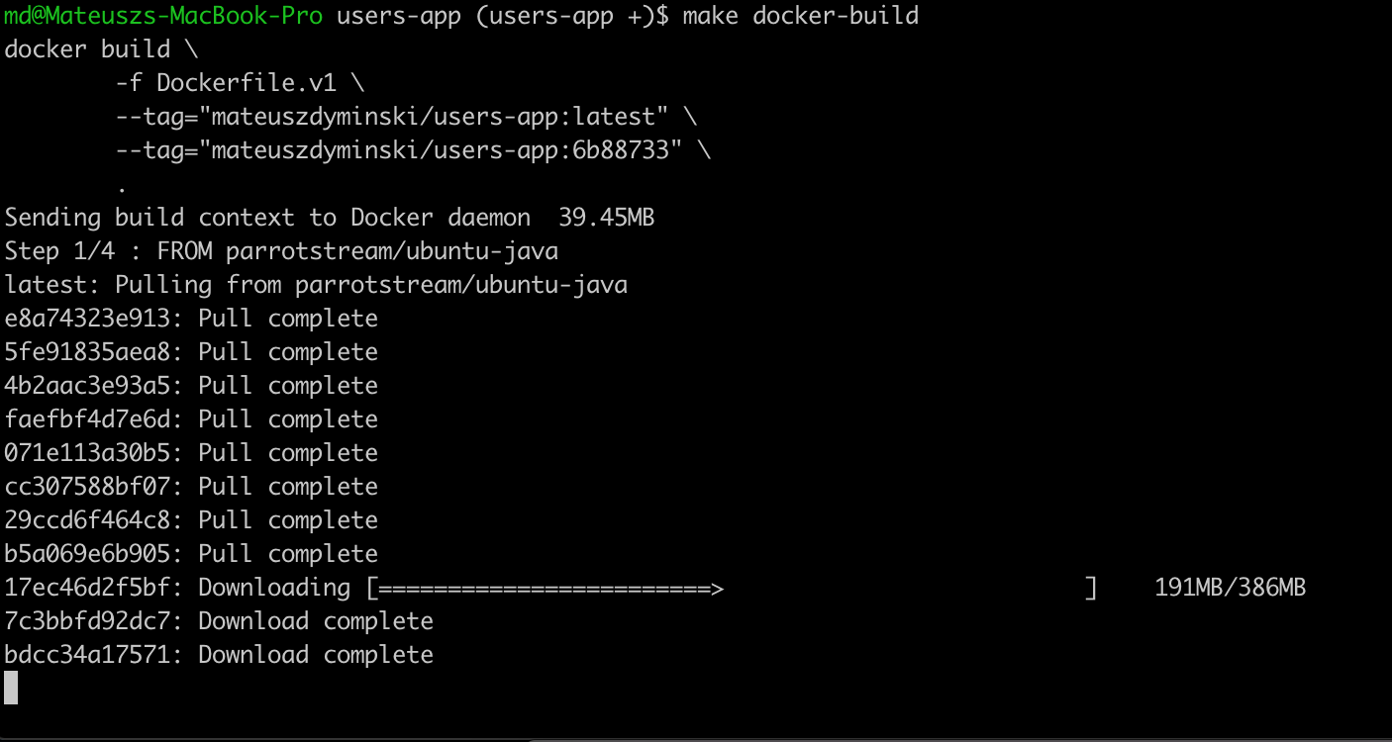


Slide 21
Volume Plugin
A way to reference block device or mounted filesystem
Ordered Volume is accessible by all containers in pod
Volume plugin specifies
How volume is setup in pod
Where the data resides
Lifetime of volume could be longer than lifetime of pod

Slide 22
Kubernetes Storage - options
File Storage
NFS, SMB, etc.
Block Storage
GCE PD, AWS EBS, iSCSI, Fibre Channel, etc.
File on Block Storage
Data Path Standarized – Posix, SCSI

Slide 23
Kubernetes Volumes Plugins
Remote Storage
GCE Persistent Disk
AWS Elastic Block Store
Azure File Storage
Azure Data Disk
Dell EMC ScaleIO
iSCSI
Flocker
NFS
vSphere
GlusterFS
Ceph File and RBD
Cinder
Quobyte Volume
FibreChannel
VMware Photon PD
Ephemeral Storage
EmptyDir
Expose Kubernetes API
Secret
ConfigMap
DownwardAPI
Local Persistent Volume
Out-of-Tree
Flex (exec a binary)
CSI
Host path

Slide 24

Ephemeral Storage

Slide 25
Ephemeral Storage - EmptyDir
apiVersion: apps/v1
kind: Pod
metadata:
name: mysql
spec:
containers:
- image: mysql:5.6
name: mysql
env:
- name: MYSQL_ROOT_PASSWORD
value: password
ports:
- containerPort: 3306
name: mysql
volumeMounts:
- name: data
mountPath: /var/lib/mysql
volumes:
- name: data
emptyDir: {}

Slide 26
Ephemeral Storage
Built on top of EmptyDir:
Secret Volume
ConfigMap Volume
DownwardAPI Volume
Populate Kubernetes API as files in to an EmptyDir

Slide 27
Ephemeral Storage – ConfigMap
apiVersion: apps/v1
kind: Pod
metadata:
name: mysql
spec:
containers:
- image: mysql:5.6
name: mysql
env:
- name: MYSQL_ROOT_PASSWORD
value: password
ports:
- containerPort: 3306
name: mysql
volumeMounts:
- name: config-map
mountPath: /etc/mysql.conf
volumes:
- name: config-map
configMap:
name: mysql

Slide 28
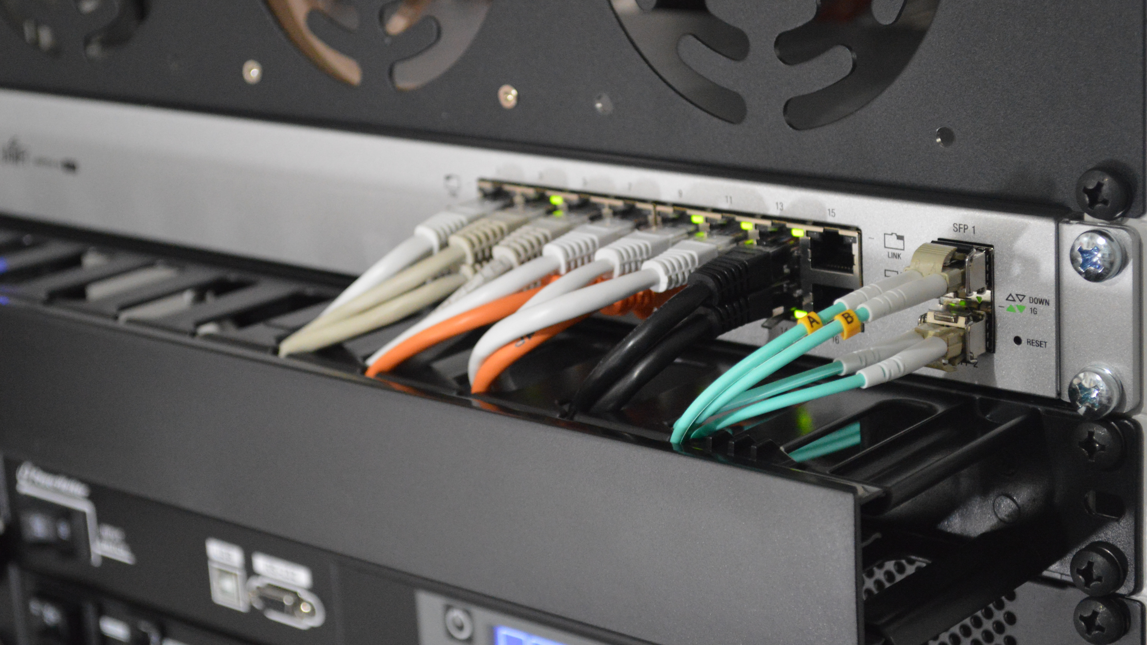
Remote Storage

Slide 29
Remote Storage – EBS example
apiVersion: apps/v1
kind: Pod
metadata:
name: mysql
spec:
containers:
- image: mysql:5.6
name: mysql
env:
- name: MYSQL_ROOT_PASSWORD
value: password
volumeMounts:
- mountPath: /var/lib/mysql
name: ebs-volume
volumes:
- name: ebs-volume
awsElasticBlockStore:
volumeID: <volume-id>
fsType: ext4
There are some restrictions when using an awsElasticBlockStore volume:
the nodes on which Pods are running must be AWS EC2 instances
those instances need to be in the same region and availability-zone as the EBS volume
EBS only supports a single EC2 instance mounting a volume
Pod yaml is no longer portable across clusters!!

Slide 30
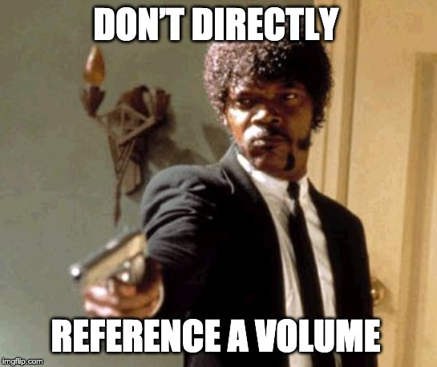

Slide 31


Persistent Volume Persistent Volume Claim

Slide 32
Persistent Volume Persistent Volume Claim
Abstracts and Decouples storage implementation from storage consumption

Slide 33
Pod mounts PersistentVolumeClaim into container(s)
apiVersion: apps/v1
kind: Pod
metadata:
name: mysql
spec:
containers:
- image: mysql:5.6
name: mysql
env:
- name: MYSQL_ROOT_PASSWORD
value: password
volumeMounts:
- name: mysql-persistent-storage
mountPath: /var/lib/mysql
volumes:
- name: mysql-persistent-storage
persistentVolumeClaim:
claimName: mysql-pv-claim
Pod yaml is portable again!!

Slide 34
PersistentVolumeClaim = request for storage
kind: PersistentVolumeClaim
apiVersion: v1
metadata:
name: mysql-pv-claim
spec:
resources:
requests:
storage: 1Gi
accessModes:
- ReadWriteOnce
"Give me 1 GiB of storage."
"That is mountable to single pod as read/write."
"And I don't really care about the rest."

Slide 35
PersistentVolumeClaim (PVC)
Application request for storage.
Created by user / devops.
Binds to single PV.
Usable in Pods.

Slide 36
PersistentVolume
kind: PersistentVolume
apiVersion: v1
metadata:
name: task-pv-volume
labels:
type: local
spec:
capacity:
storage: 10Gi
accessModes:
- ReadWriteMany
- ReadWriteOnce
- ReadOnlyMany
persistentVolumeReclaimPolicy: Retain
awsElasticBlockStore:
fsType: "ext4"
volumeID: "vol-f37a03aa"

Slide 37
PersistentVolume
kind: PersistentVolume
apiVersion: v1
metadata:
name: task-pv-volume
labels:
type: local
spec:
capacity:
storage: 10Gi
accessModes:
- ReadWriteMany
- ReadWriteOnce
- ReadOnlyMany
persistentVolumeReclaimPolicy: Retain
awsElasticBlockStore:
fsType: "ext4"
volumeID: "vol-f37a03aa"
Size of the Volume

Slide 38
PersistentVolume
kind: PersistentVolume
apiVersion: v1
metadata:
name: task-pv-volume
labels:
type: local
spec:
capacity:
storage: 10Gi
accessModes:
- ReadWriteMany
- ReadWriteOnce
- ReadOnlyMany
persistentVolumeReclaimPolicy: Retain
awsElasticBlockStore:
fsType: "ext4"
volumeID: "vol-f37a03aa"
Access modes that the
volume supports

Slide 39
PersistentVolume
kind: PersistentVolume
apiVersion: v1
metadata:
name: task-pv-volume
labels:
type: local
spec:
capacity:
storage: 10Gi
accessModes:
- ReadWriteMany
- ReadWriteOnce
- ReadOnlyMany
persistentVolumeReclaimPolicy: Retain
awsElasticBlockStore:
fsType: "ext4"
volumeID: "vol-f37a03aa"
What to do when the volume is
not needed any longer. Options:
Recycle (deprecated),
Retain,
Delete

Slide 40
PersistentVolume
kind: PersistentVolume
apiVersion: v1
metadata:
name: task-pv-volume
labels:
type: local
spec:
storageClassName: cheap
capacity:
storage: 10Gi
accessModes:
- ReadWriteMany
- ReadWriteOnce
- ReadOnlyMany
persistentVolumeReclaimPolicy: Retain
awsElasticBlockStore:
fsType: "ext4"
volumeID: "vol-f37a03aa"
Pointer to Storage
AWS EBS, Azure DD, Ceph FS & RBD, CSI, FC, Flex, GCE PD, Gluster, iSCSI, NFS, OpenStack Cinder,
Photon, Quobyte, StorageOS, vSphere

Slide 41
PV and PVC step by step
$ kubectl create -f pv.yaml
persistentvolum/task-pv-volume created

Slide 42
PV and PVC step by step
$ kubectl create -f pv.yaml
persistentvolum/task-pv-volume created
$ kubectl get pv
NAME CAPACITY ACCESSMODES STATUS CLAIM REASON AGE
task-pv-volume 10Gi RWO Available 1m

Slide 43
PV and PVC step by step
$ kubectl create -f pv.yaml
persistentvolum/task-pv-volume created
$ kubectl get pv
NAME CAPACITY ACCESSMODES STATUS CLAIM REASON AGE
task-pv-volume 10Gi RWO Available 1m
$ kubectl create -f pvc.yaml
persistentvolumeclaim/mysql-pv-claim created

Slide 44
PV and PVC step by step
$ kubectl create -f pv.yaml
persistentvolum/task-pv-volume created
$ kubectl get pv
NAME CAPACITY ACCESSMODES STATUS CLAIM REASON AGE
task-pv-volume 10Gi RWO Available 1m
$ kubectl create -f pvc.yaml
persistentvolumeclaim/mysql-pv-claim created
$ kubectl get pvc
NAME STATUS VOLUME CAPACITY ACCESSMODES STORAGECLASS AGE
my-mysql-claim Bound pvc-6428 10Gi RWO standard 1m

Slide 45
PV and PVC step by step
$ kubectl create -f pv.yaml
persistentvolum/task-pv-volume created
$ kubectl get pv
NAME CAPACITY ACCESSMODES STATUS CLAIM REASON AGE
task-pv-volume 10Gi RWO Available 1m
$ kubectl create -f pvc.yaml
persistentvolumeclaim/mysql-pv-claim created
$ kubectl get pvc
NAME STATUS VOLUME CAPACITY ACCESSMODES STORAGECLASS AGE
my-mysql-claim Bound pvc-6428 10Gi RWO standard 1m
$ kubectl get pv
NAME CAPACITY ACCESSMODES STATUS CLAIM REASON AGE
task-pv-volume 10Gi RWO Bound mysql-pv-claim 1m

Slide 46
Dynamic provisioning
Cluster admin pre-provisioning PVs is painful and wasteful.
Dynamic provisioning creates new volumes on-demand (when requested by user).
Eliminates need for cluster administrators to pre-provision storage.

Slide 47
Dynamic provisioning
Dynamic provisioning “enabled” by creating StorageClass.
StorageClass defines the parameters used during creation.
StorageClass parameters opaque to Kubernetes so storage providers can expose any number of custom parameters for the cluster admin to use.

Slide 48
StorageClass
kind: StorageClass
apiVersion: storage.k8s.io/v1
metadata:
name: slow
provisioner: kubernetes.io/gce-pd
annotations:
storageclass.kubernetes.io/is-default-class: "true"
parameters:
type: pd-standard
zone: us-east1-d
Collection of PersistentVolumes with the same characteristics.
Usually admin territory.
Global, not namespaced.

Slide 49
StorageClass
kind: StorageClass
apiVersion: storage.k8s.io/v1
metadata:
name: slow
provisioner: kubernetes.io/gce-pd
annotations:
storageclass.kubernetes.io/is-default-class: "true"
parameters:
type: pd-standard
zone: us-east1-d
Who dynamically provisions volumes.
Name of hardcoded volume plugin.
Name of external provisioner.
Name of CSI driver.

Slide 50
StorageClass
kind: StorageClass
apiVersion: storage.k8s.io/v1
metadata:
name: slow
provisioner: kubernetes.io/gce-pd
annotations:
storageclass.kubernetes.io/is-default-class: "true"
parameters:
type: pd-standard
zone: us-east1-d
Parameters for dynamic provisioning.
Depend on the provisioner.

Slide 51
StorageClass
kind: StorageClass
apiVersion: storage.k8s.io/v1
metadata:
name: slow
provisioner: kubernetes.io/gce-pd
annotations:
storageclass.kubernetes.io/is-default-class: "true"
parameters:
type: pd-standard
zone: us-east1-d
One StorageClass in the cluster can be default.
PVC without any StorageClass gets the default one.

Slide 52
Dynamic Provisioning Step by Step

Slide 53
Dynamic Provisioning – mysql yaml
apiVersion: apps/v1
kind: Pod
metadata:
name: mysql
spec:
containers:
- image: mysql:5.6
name: mysql
env:
- name: MYSQL_ROOT_PASSWORD
value: password
volumeMounts:
- name: mysql-persistent-storage
mountPath: /var/lib/mysql
volumes:
- name: mysql-persistent-storage
persistentVolumeClaim:
claimName: mysql-pv-claim
We don’t need to touch Pod Yaml

Slide 54
Dynamic Provisioning – PVC yaml
kind: PersistentVolumeClaim
apiVersion: v1
metadata:
name: mysql-pv-claim
spec:
resources:
requests:
storage: 1Gi
accessModes:
- ReadWriteOnce
storageClassName: slow
We need to add storageClassName

Slide 55
Dynamic Provisioning - step by step
$ kubectl create -f storage_class.yaml
storageclass „slow” created

Slide 56
Dynamic Provisioning - step by step
$ kubectl create -f storage_class.yaml
storageclass „slow” created
$ kubectl create -f pvc.yaml
persistentvolumeclaim/mysql-pv-claim created

Slide 57
Dynamic Provisioning - step by step
$ kubectl create -f storage_class.yaml
storageclass „slow” created
$ kubectl create -f pvc.yaml
persistentvolumeclaim/mysql-pv-claim created
$ kubectl get pvc
NAME STATUS VOLUME CAPACITY ACCESSMODES STORAGECLASS AGE
my-mysql-claim Bound pvc-6428 10Gi RWO standard 1m

Slide 58
Dynamic Provisioning - step by step
$ kubectl create -f storage_class.yaml
storageclass „slow” created
$ kubectl create -f pvc.yaml
persistentvolumeclaim/mysql-pv-claim created
$ kubectl get pvc
NAME STATUS VOLUME CAPACITY ACCESSMODES STORAGECLASS AGE
my-mysql-claim Bound pvc-6428 10Gi RWO standard 1m
$ kubectl get pv
NAME CAPACITY ACCESSMODES STATUS CLAIM REASON AGE
task-pv-volume 10Gi RWO Bound mysql-pv-claim 1m

Slide 59
PV and PVC release
$ kubectl delete pvc mysql-pv-claim
persistentvolumeclaim „mysql-pv-claim” deleted

Slide 60
PersistentVolume – Release
PVC is deleted: persistentVolumeReclaimPolicy is executed:
Recycle (deprecated):
All data from the volume are removed ("rm -rf *").
PV is Available for new PVCs.
Delete:
Volume is deleted in the storage backend.
PV is deleted.
Usually for dynamically-provisioned volumes
Retain:
PV is kept Released.
No PVC can bind to it.
Admin should manually prune Released volumes. In all cases, user can't access the data!

Slide 61
Stateful applications

Slide 62
Deployment
Runs X replicas of a single Pod template.
When a pod is deleted, Deployment automatically creates a new one.
Scalable up & down.
All pods share the same PVC!

Slide 63
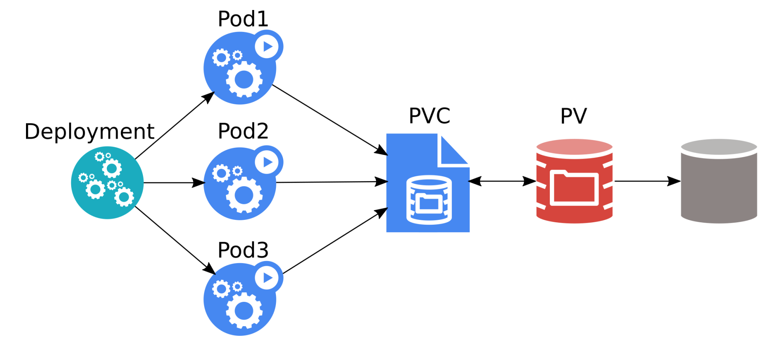
Deployment
Source: Kubernetes Storage 101 - Jan Šafránek, Red Hat & David Zhu, Google

Slide 64
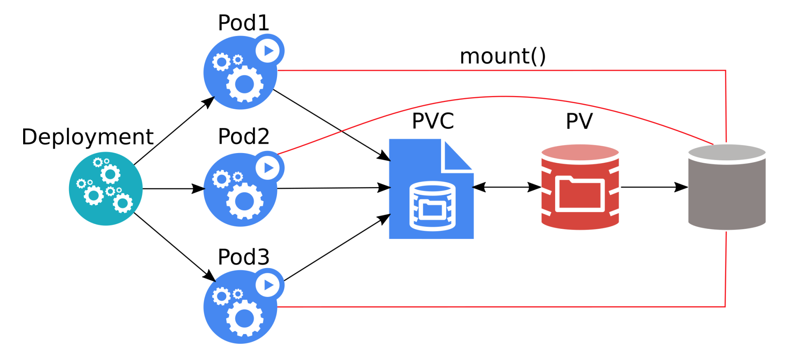
Deployment
All three pods can overwrite data of each other!
Most applications crash / refuse to work.
Source: Kubernetes Storage 101 - Jan Šafránek, Red Hat & David Zhu, Google

Slide 65
StatefulSet
Runs X replicas of a single Pod template.
Each pod gets its own PVC(s) from a PVC template.
When a pod is deleted, StatefulSet automatically creates a new one.
Each pod has a stable identity.
Scalable up & down.

Slide 66
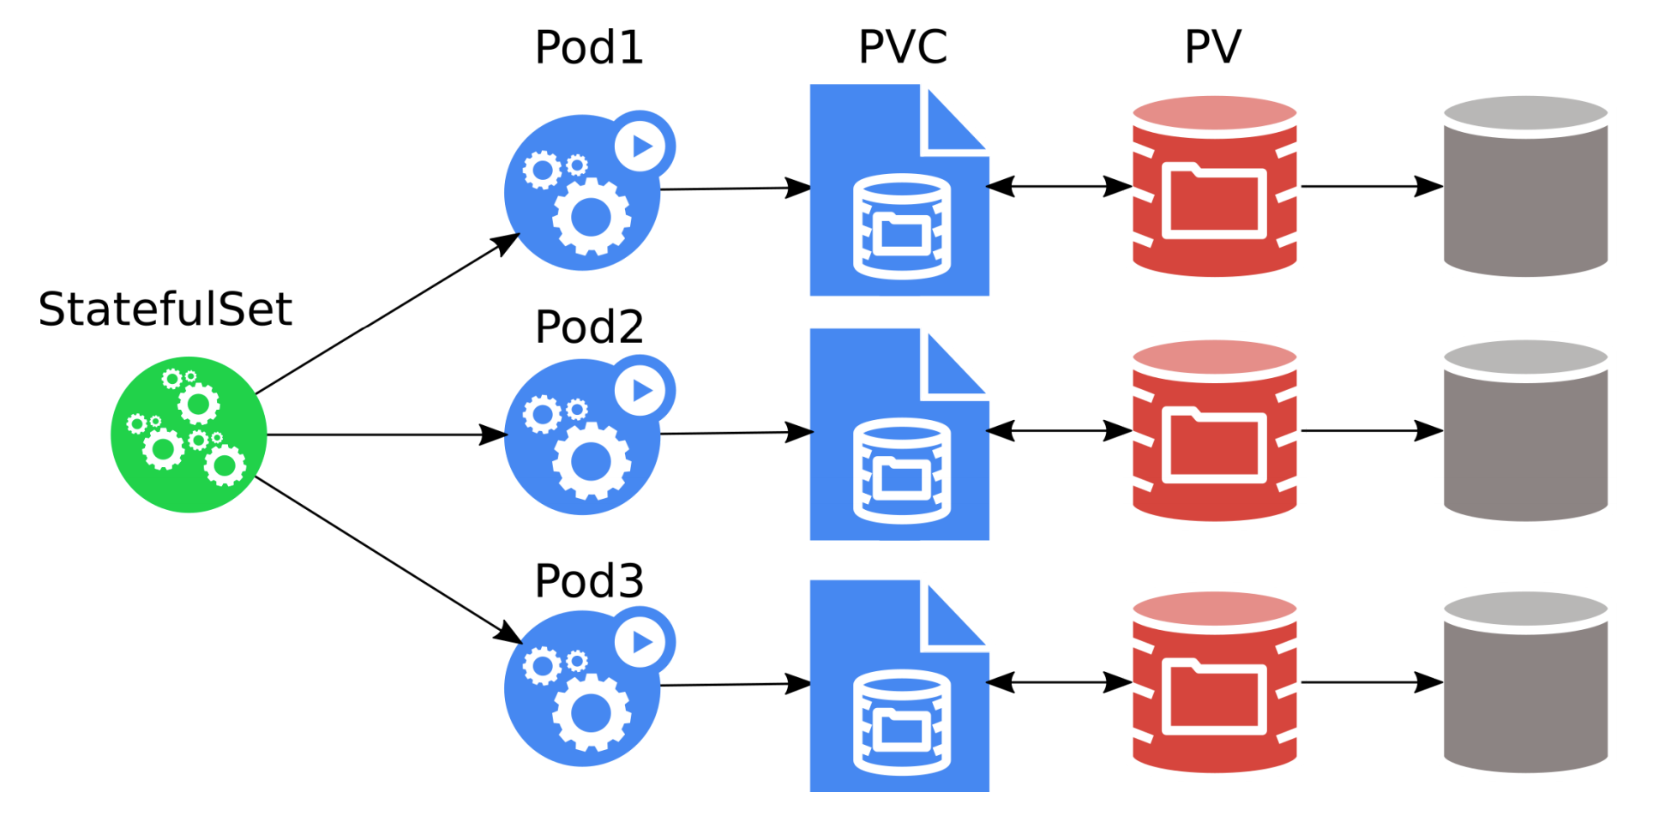
StatefulSet
The pods must be aware of the other StatefulSet members!
Source: Kubernetes Storage 101 - Jan Šafránek, Red Hat & David Zhu, Google

Slide 67
StatefulSet vs Deployment
apiVersion: apps/v1
kind: StatefulSet
metadata:
name: mysql
spec:
selector:
matchLabels:
app: mysql
serviceName: "mysql"
replicas: 3
template:
metadata:
labels:
app: mysql
spec:
containers:
- name: mysql
image: mysql:5.6
volumeMounts:
- name: mysql-persistent-storage
mountPath: /var/lib/mysql
volumeClaimTemplates:
- metadata:
name: mysql-persistent-storage
spec:
accessModes: [ "ReadWriteOnce" ]
storageClassName: "slow"
resources:
requests:
storage: 1Gi
apiVersion: apps/v1
kind: Pod
metadata:
name: mysql
spec:
containers:
- image: mysql:5.6
name: mysql
env:
- name: MYSQL_ROOT_PASSWORD
value: password
volumeMounts:
- name: mysql-persistent-storage
mountPath: /var/lib/mysql
volumes:
- name: mysql-persistent-storage
persistentVolumeClaim:
claimName: mysql-pv-claim

Slide 68
Kubernetes Volumes Plugins
Remote Storage
GCE Persistent Disk
AWS Elastic Block Store
Azure File Storage
Azure Data Disk
Dell EMC ScaleIO
iSCSI
Flocker
NFS
vSphere
GlusterFS
Ceph File and RBD
Cinder
Quobyte Volume
FibreChannel
VMware Photon PD
Ephemeral Storage
EmptyDir
Expose Kubernetes API
Secret
ConfigMap
DownwardAPI
Local Persistent Volume
Out-of-Tree
Flex (exec a binary)
CSI
Host path

Slide 69
Local Volumes
Local disks can be used as PVs.
Expose a local block or file as a PersistentVolume
Reduced durability
Extra speed
Useful for building distributed storage systems
Useful for high performance caching
Kubernetes takes care of data gravity
Referenced via PV/”PVC so workload portability is maintained

Slide 70


Slide 71
CSI = Container Storage Interface
Container Storage Interface (CSI) is an initiative to unify the storage interface of Container Orchestrator Systems (COs) like Kubernetes, Mesos, Docker swarm, cloud foundry, etc.
Implementing a single CSI for a storage vendor is guaranteed to work with all COs.

Slide 72
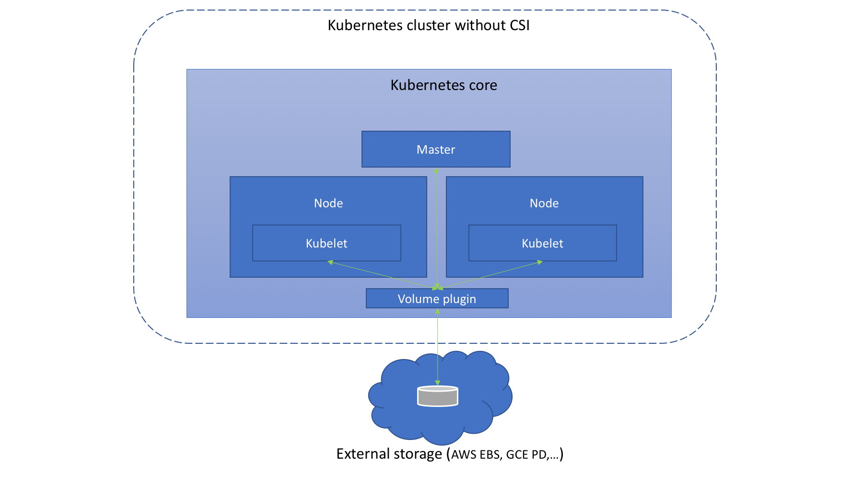
Before CSI
Source: https://medium.com/google-cloud/understanding-the-container-storage-interface-csi-ddbeb966a3b

Slide 73
Before CSI - problems
Volume plugin development coupled and dependent on Kubernetes releases.
Kubernetes developers/community are responsible for testing and maintaining all volume plugins.
Bugs in volume plugins can crash Kubernetes core components
Volume plugins get full privileges of kubernetes components (kubelet and kube-controller-manager).
Plugin developers are forced to make plugin source code available – open-source

Slide 74
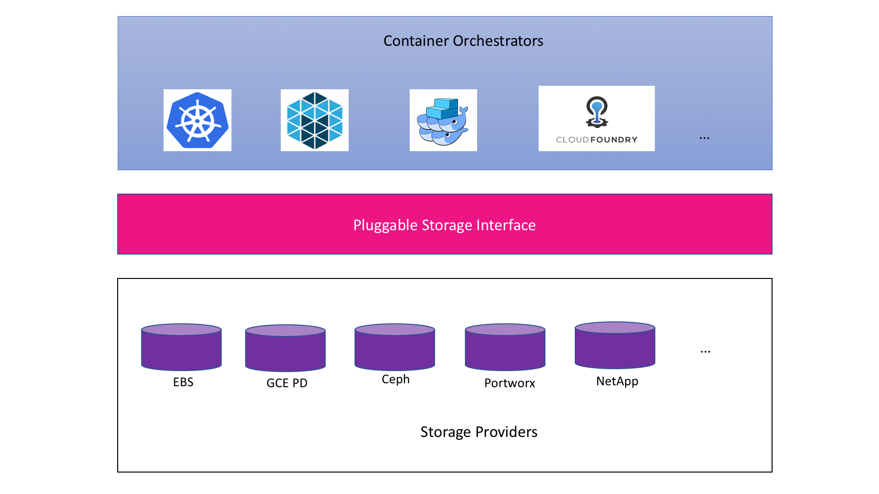
CSI concept
Source: CloudNativeCon EU 2018 CSI Jie Yu

Slide 75
CSI exmaple
kind: StorageClass
apiVersion: storage.k8s.io/v1
metadata:
name: fast-storage
provisioner: csi-driver.example.com
parameters:
type: pd-ssd
csi.storage.k8s.io/provisioner-secret-name: mysecret
csi.storage.k8s.io/provisioner-secret-namespace: mynamespace

Slide 76
CSI – materials
Webpage - https://kubernetes-csi.github.io/
Specification - https://github.com/container-storage-interface/spec
Great talks:
Container Storage Interface: Present and Future - Jie Yu
Container Storage Interface for Kubernetes

Slide 77

Storage features

Slide 78
Resize of PV
Only expansion is supported.
Offline.
Online (alpha).

Slide 79
Snapshots
Part of CSI.
Can take a snapshot of PVC.
PVC can be provisioned from a snapshot.
VolumeSnapshotContent, VolumeSnapshot, VolumeSnapshotClass CRDs are intruduced
More: https://kubernetes.io/blog/2018/10/09/introducing-volume-snapshot-alpha-for-kubernetes/

Slide 80


Slide 81
Myth 1: Applications in containers must be stateless
Unless persistent volume is used
Statistic shows that 40% of workloads are stateful
It’s myth

Slide 82
Myth 2: Writes done by container apps are slow
hostPath and Local Volumes are almost as fast as bare metal
Perf depends on remote storage
Perf depends on cloud provider
You need to test it by your own
Tools:
Sysbench
Pg_bench
Recommended to watch
Benchmarking Cloud Native Storage - Josh Berkus, Red Hat – KubeCon Europe 2019 - https://www.youtube.com/watch?v=4V-4yPSfN3U
It’s not myth

Slide 83
Myth 3: Storing data on k8s requires remote distributed storage
It’s myth
We have an options:
Persistent Local Volume
Host Path – don’t use it unless you know what you are doing

Slide 84
Myth 4: Never run DB on k8s
It’s myth
But:
DB as a service >>>> DB in K8s

Slide 85

Summary

Slide 86
Takeaways

Slide 87

Q&A

